Slide 1

DECISION MAKING IN SPM
VANEEZA SHAHZADI
BSCS-F19-M-62
MORNING SECTION B

Slide 2

INTRODUCTION
SOFTWARE PROJECT MANAGEMENT
DECISION MAKING
NATUTURILISTIC DECISION MAKING
SYSTEMETIC LITERATURE REVIEW

Slide 3

BACKGROUND
NAME | YEAR | PROBLEM | METHOD | CONCLUSION
Nils Brede Moi | 2013 | Decision-making process in agile teams | scrum practices and second identifies factors | Agile teams face many difficulties in decision making. More research can be done in order to fulfil the gape between decision making and agile team.
Aybuke Aurum | 05 July 2016 | The role of strategic performance measures (SPM) in strategic decision-making | Survey study | SPM of efficiency and effectiveness are positively associated with performance
J. Warsta | 30 Aug 2011 | Exploring Software Product Management decision problems | Constraint Satisfaction Problem (CSP) | Advantages and limitations of CSP modeling in SPM

Slide 4
BACKGROUND
NAME | YEAR | PROBLEM | METHOD | CONCLUSION
Zayyad Nayako | 2008 | Decision-making process in agile software development | Scrum team process | A prerequisite for introducing Scrum is the alignment of decisions on a strategic, tactical and operational level.
Peter oriogun | 24-26 September 2012 | Decision Making responsibilities and also a solution to the generalization of the present code of ethics. | Case studies | There are codes of ethics in Software Engineering to guide software engineers on ethical decision making, it is not enough because it is general.

Slide 5
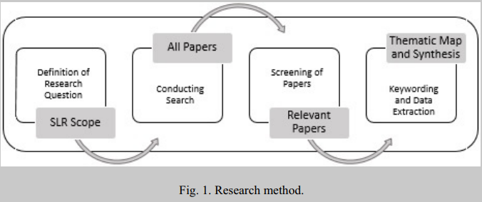

METHODOLOGY
The main methodology employed in this research paper is the literature review of many other researches.

Slide 6

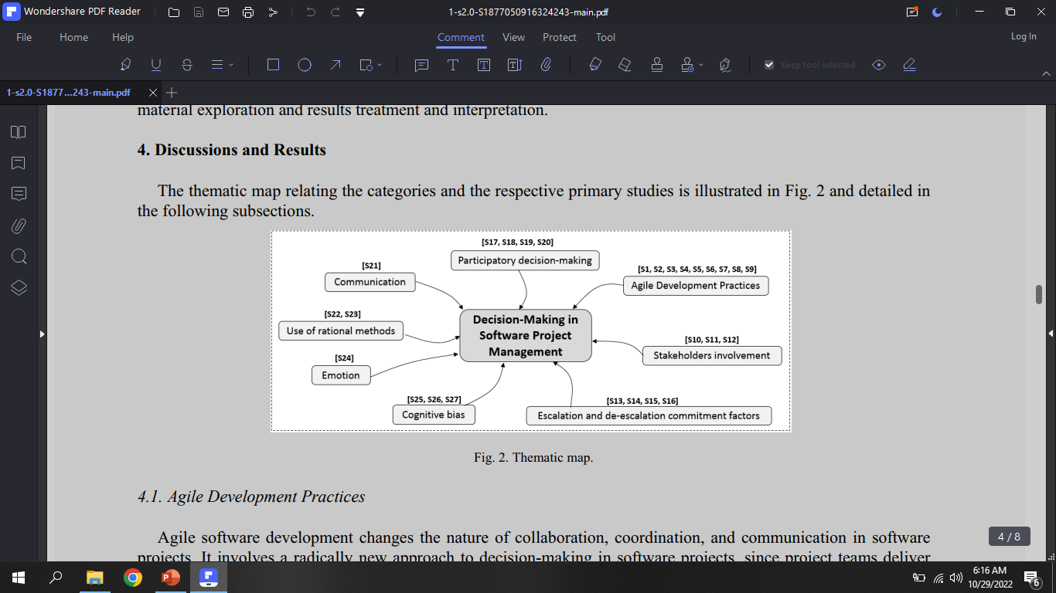
DISCUSSION

Slide 7

CONCLUSION
The researches in all above categories reveals that there is a lot to discover and more researches are required for understanding how decision making is being done by the decision makers.
Decision making is compromised often according to the research which leads to project failure and may cause many difficulties during project management.

Slide 8


